Slide 1
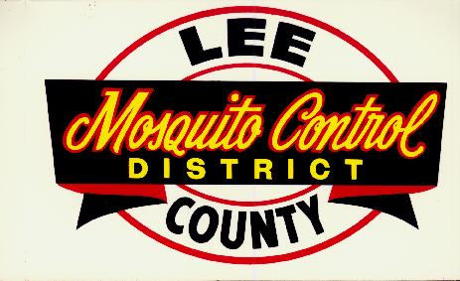
Lee County Mosquito Control District’s Response to Suspected Cases and Outbreaks of Mosquito-borne Diseases.

Slide 2
Background
Endemic Mosquito-borne Diseases in Florida
SLE, EEE, and WNV
Imported Mosquito-borne Diseases
Malaria and Dengue
New and Emerging Mosquito-borne Diseases
Chikungunya and Zika Virus

Slide 3
Preventative Measures
Early detection
Appropriate mosquito control response
Education

Slide 4
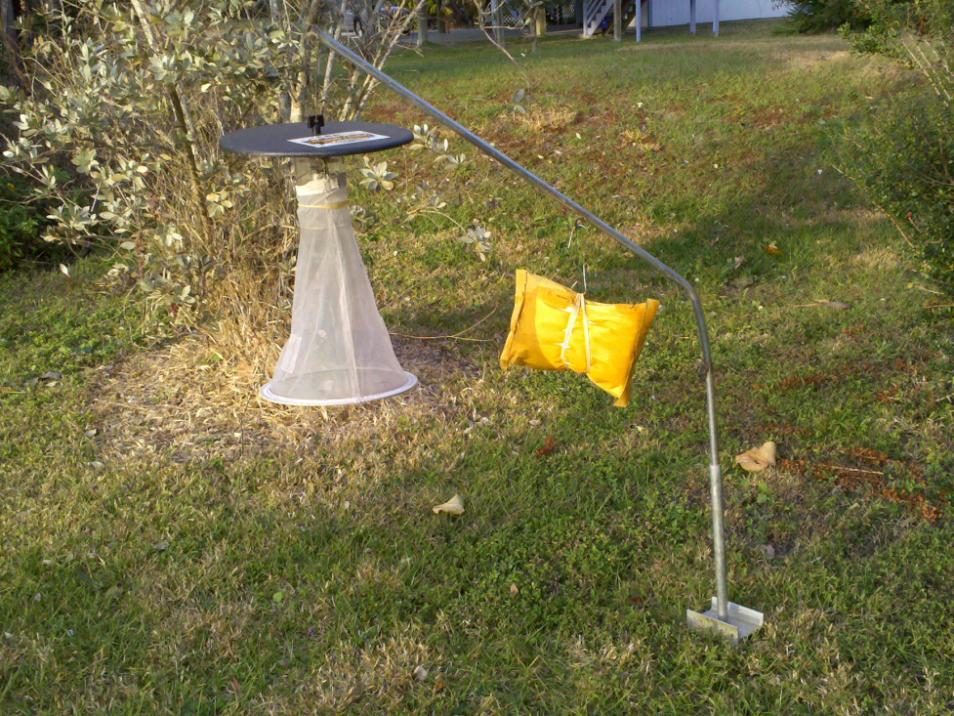
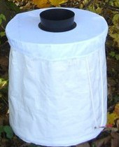
Early Detection
Active mosquito pool collections
CDC light traps
BG Sentinel traps

Slide 5
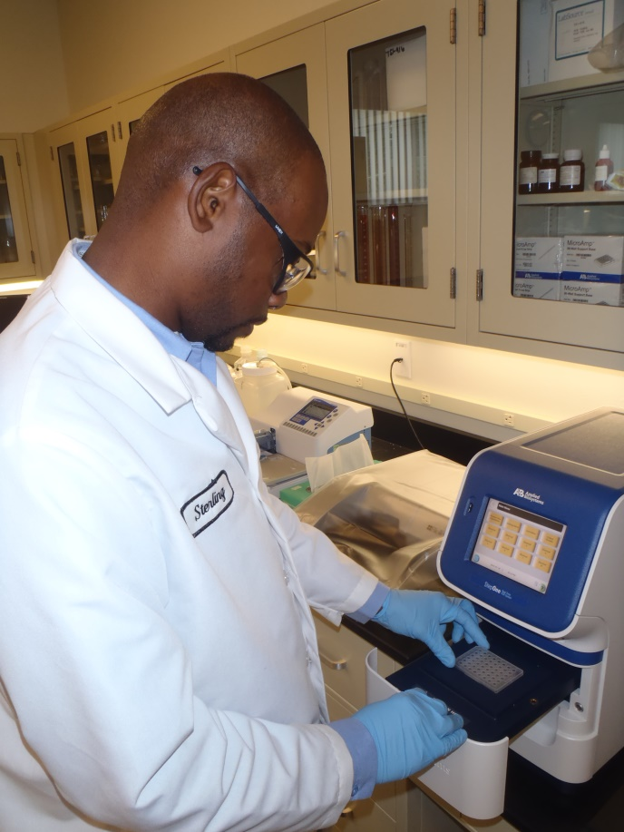
Early Detection
PCR testing for viral RNA

Slide 6
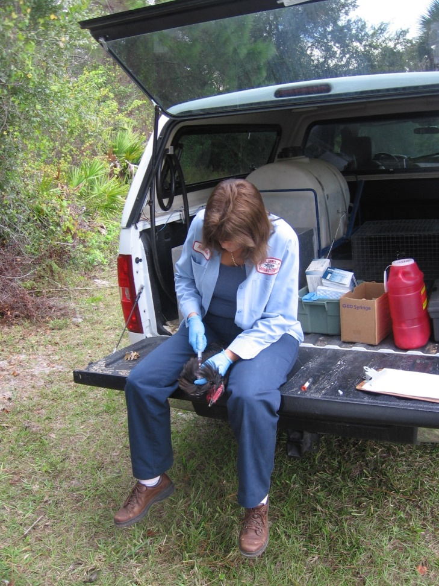
Early Detection
Active sentinel chicken sample collections from 17 different sites.

Slide 7
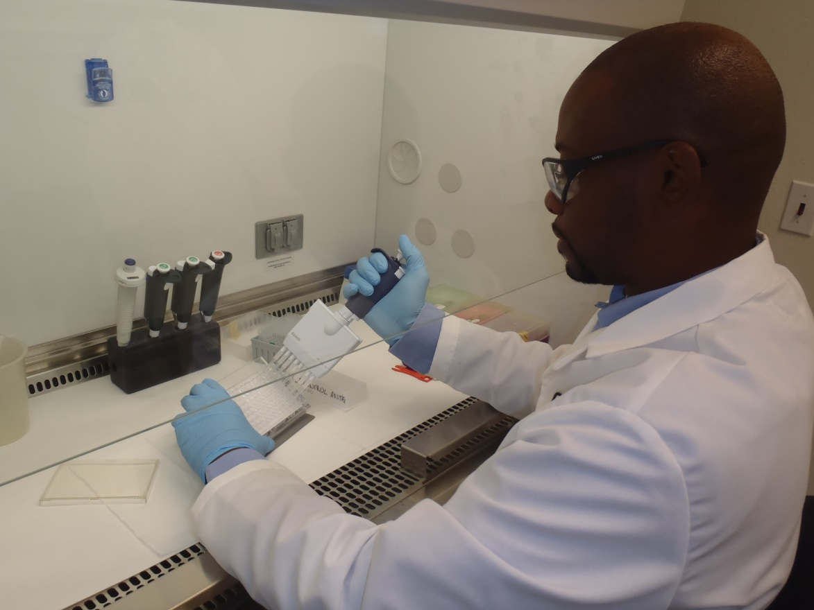
Early Detection
ELISA testing for IgG antibody response

Slide 8
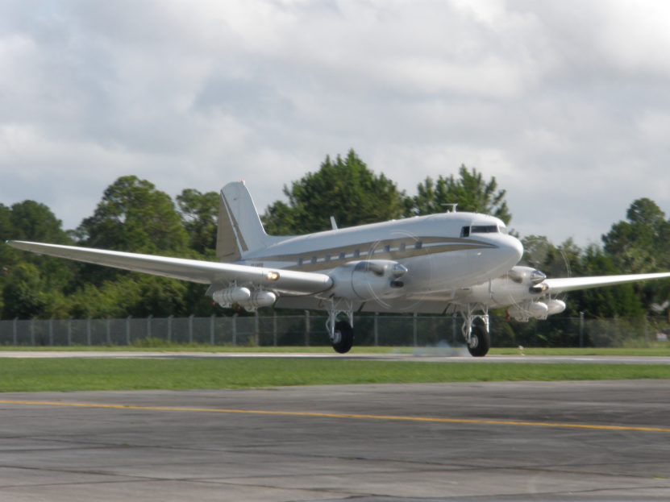
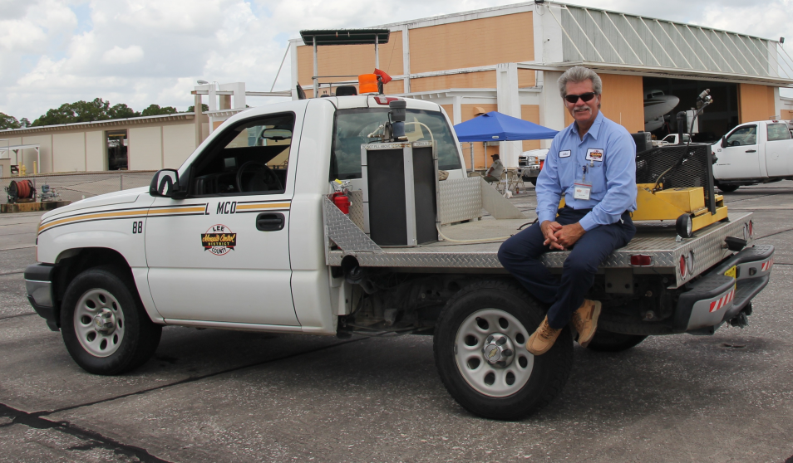
Appropriate Mosquito Control Response
Aerial adulticiding
Ground adulticiding

Slide 9
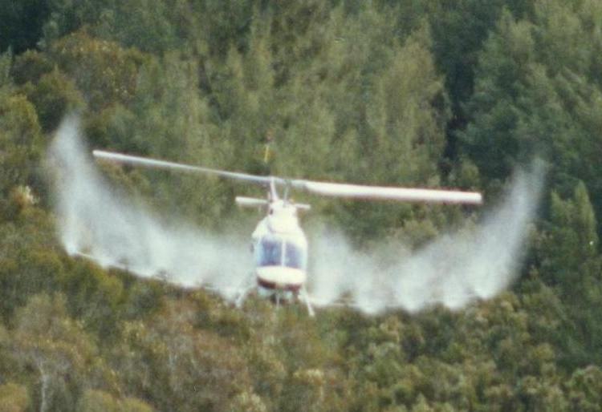
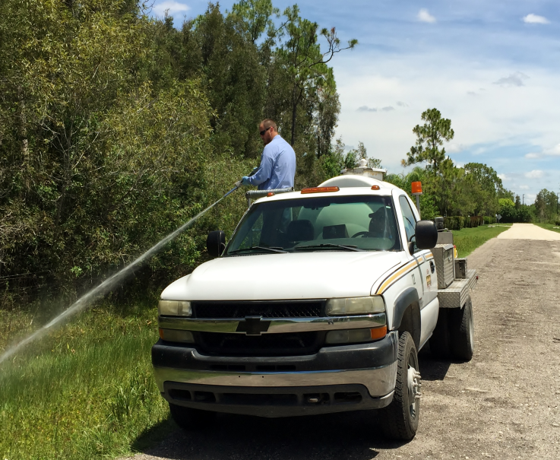
Appropriate Mosquito Control Response
Aerial larviciding
Ground larviciding

Slide 10
Human Disease Response
 | Human Disease Notification
 |  |  |  | Sentinel Chicken Positive
 | Notification from Health Department
 |  |  |  |  |  |  |  |  | Non-Human Resevoir
 |  |  |  | Human Case
 |  |  |  |  |  |  |  |  | Human Reservoir
 |  |  |  |  |  |  |  |  | Travel Related |  | Locally Aquired

Slide 11
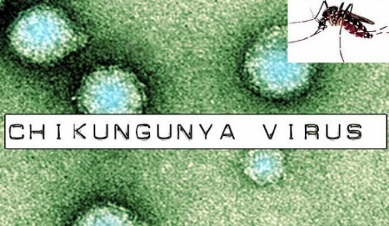
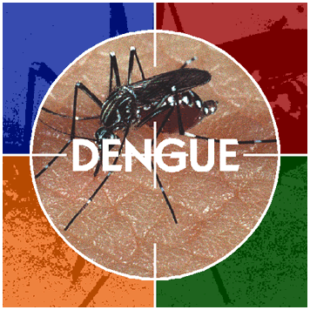
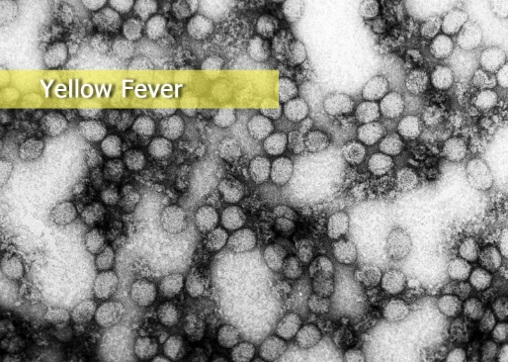
Human Disease Notification
Human Case
Sentinel Chicken Positive

Slide 12
Human Disease Notification
Human Case
Receive alert from local Health Department
Rapid control response upon notification
Check area for vector mosquitoes
Treat area with adulticide
Human Reservoir and Non-Human Reservoir

Slide 13
Human Reservoir Response

Slide 14
Human Reservoir Response
Human Reservoir
Locally acquired and Travel related

Slide 15
Human Reservoir Response
Locally acquired cases
Trap and visual inspection of the area
Day 1: Aerial treatment with adulticide at sunset
Day 2: Aerial larvicide urban area within 1 mile of the case
Aerial adulticide or ground adulticide with ULV trucks within 1 mile of case
Back-check area for adult mosquito with BG Sentinel traps for Ae. aegypti
PCR testing on vector mosquito from traps

Slide 16
Human Reservoir Response
Travel Related or Imported Case
Ground surveillance or adult mosquito trapping with BG Sentinel traps for Ae. Aegypti
If warranted, area treated by ground adulticide ULV truck 2 successive nights within ½ mile of the case
Depends on the viral transmission cycle
Human to mosquito to human
Malaria, Dengue, Chikangunya, and Zika
Trap and inspect for vector mosquitoes
Ground adulticide treatment

Slide 17
Non-Human Reservoir Response
 | Non-Human Reservior Arbovirus Response Flowchart
 |  | Locally Aquired |  |  | All Cases |  |  |  | Aerial Adulticide, sunset |  |  | Aerial Adulticide or Ground Adulticide ULV Truck |  |  | Adult Trapping, CDC Light Trap or ground surveillence

Slide 18
Non-Human Reservoir Response
All Locally Acquired Cases
Treated with adulticide at sunset
Aerial adulticide or ground adulticide by ULV truck
Ground surveillance or adult trapping with CDC light traps

Slide 19
Sentinel Chicken Result Response
 | Pro-Active Sentinel Chicken Arbovirus Surveillance Result Response Flowchart
 |  |  |  |  |  |  |  |  |  | Single Flock |  |  |  | Measured Response |  |  | Ground Adulticide ULV Truck, 2 Successive Nights, Zones Up to 1 Mile of Flock
 |  |  | Single Bird Conversion
 |  |  |  |  |  |  |  |  |  |  |  |  |  | Measured Response
 |  |  |  |  |  |  |  |  |  | Regional Flocks
 | No Recent County Wide Conversions |  |  | Continued Bird Conversions
 |  |  | Multiple Bird Conversion |  |  |  |  |  |  |  |  |  |  | Immediate Response |  |  | Aerial Adulticide
 | Ongoing County Wide Conversions
 | Eastern Equine Encephalitis

Slide 20
Active Sentinel Chicken Surveillance Response
Chicken serum samples collected from sites county-wide
Sample duplicates are sent to Florida Department of Health for testing
District samples tested using ELISA for virus immune response.
Test for WNV, SLEV, and EEEV
Positive samples are reported to the state laboratory.

Slide 21
Active Sentinel Chicken Surveillance Response cont.
Information passed on to larvicide and adulticide crew
Area is treated with adulticide by ULV truck two nights in a row to get as many vectors as possible.
Area larvicide by ditch truck
Positive sites are back-checked by collecting chicken serum samples for retesting.

Slide 22
Active Mosquito Surveillance and Response
Target vector mosquitoes are collected from CDC light traps and BG traps throughout the county.
Pooled mosquitoes are tested using PCR
Test for WNV, SLEV, EEEV, DENV 1-4, CHIKV, and ZIKA Virus (testing capability under development)
Positive samples are reported and sent to the Florida Department of Health Laboratory for confirmation.

Slide 23
Active Mosquito Surveillance and Response cont.
Positive areas are treated by aerial adulticide
Area back-check trapping for vector(s)

Slide 24
Education Response
Keep the public Informed
Local government
Town Hall Meetings
Pamphlets at libraries, daycares and places were people gather
Website
Update daily
Area of website dedicated to issue
Media
Press releases
Public service announcements

Slide 25
Acknowledgement
Wayne Gale
Jonathan Hornby
Katie Heggemier
Shelly Redovan
Brian Cotterill

Slide 26
Thank You!!! Any Questions?

